Slide 1

Find your crowd
Members:
Mark Akritov
Narine Levonyan
Julietta Ghazaryan
Hripsime Smbatyan

Slide 2
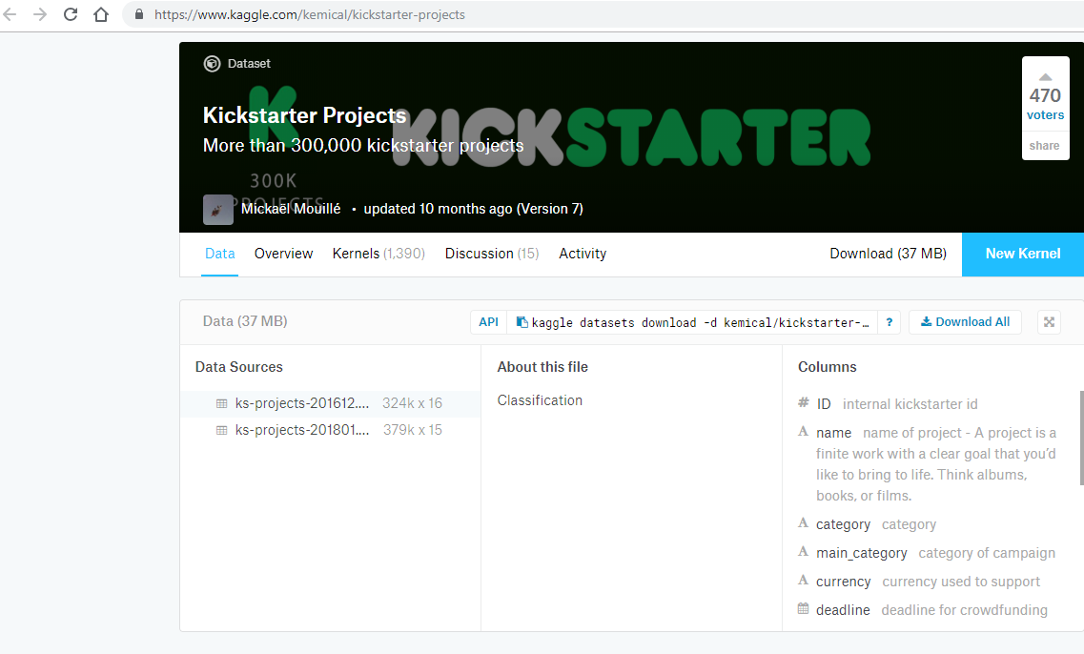
Source

Slide 3
Models
Logistic regression,
Decision tree, Random forest
Gradient boosting classifiers
Neural network
Linear regression

Slide 4
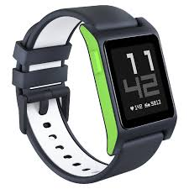
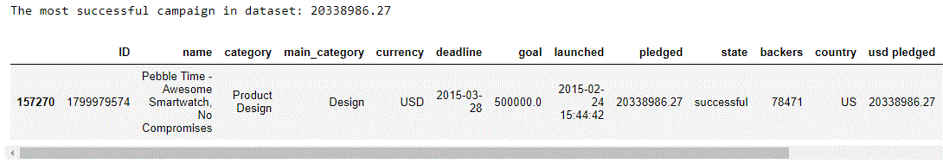
Best campaign

Slide 5
Average performance
Average pledged money in projects: 9058.92
Average goal in projects: 45454.4
Average backers in projects: 105.62
Average duration of projects: 32.9
Average pledged money per backer: 64.58

Slide 6
Categories of “state” variable
failed 52.21 %
successful 35.38 %
canceled 10.24 %
undefined 0.94 %
live 0.74 %
suspended 0.49 %

Slide 7
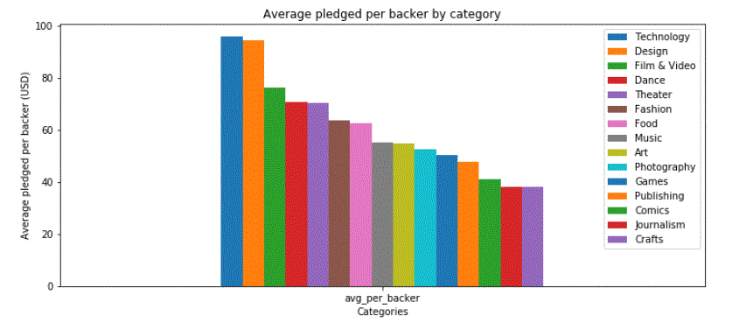

Slide 8
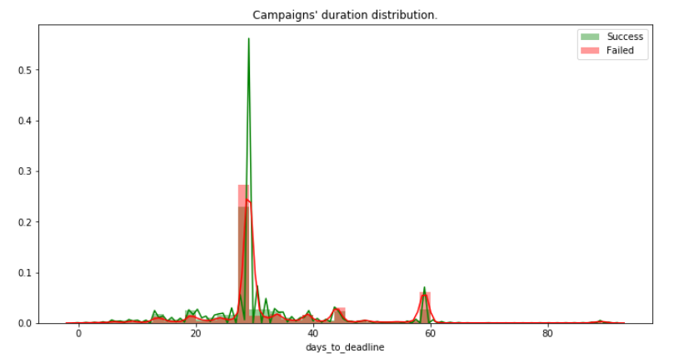

Slide 9
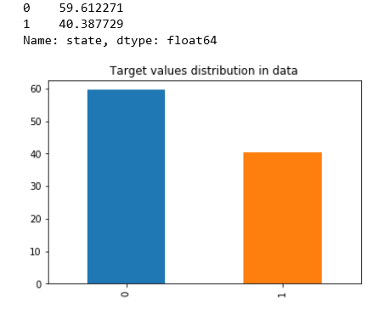

Slide 10
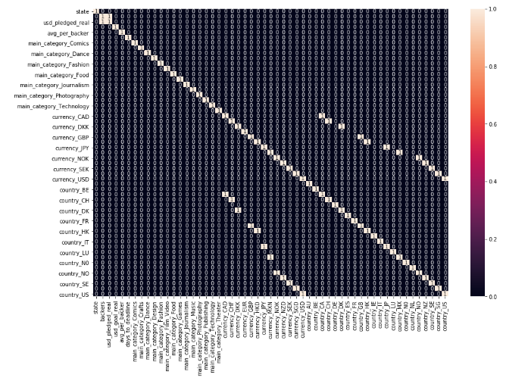
High correlation between country and currency

Slide 11
Significant variables based on logit
Backers
Usd_goal_real
Days_to_deadline
Main_category (categorical)
Country (categorical)

Slide 12
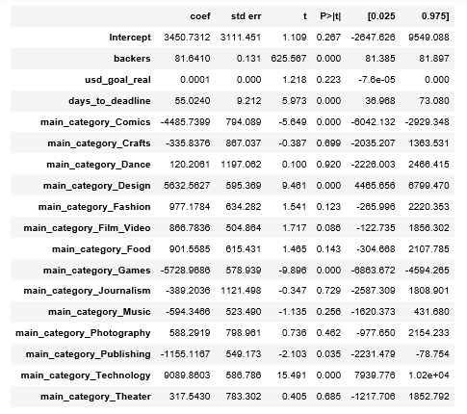
Linear regression
Significant if P-value < 0.05
Example: backers, days_to_deadline

Slide 13
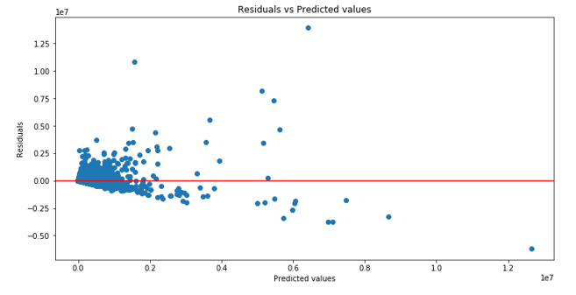
Heteroscedasticity and linearity

Slide 14

Rainbow test
Reject the null hypothesis so the model is linear

Slide 15
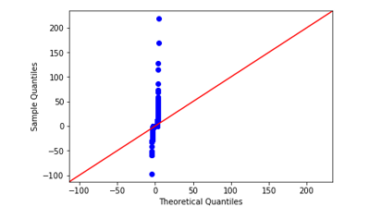
Normality assumption is violated

Slide 16

Tuning hyperparameters for logit and decision tree
Our computers couldn’t handle the number of observations we had, so:
we sampled the data into fewer observations,
tuned hyperparameters,
use them for models.

Slide 17
Best parameters for logistic regression
Best parameters for decision tree
class-weight=None
criterion= gini
max-depth=5 min_simple_leaf=170
‘C’ 0.45
class-weight=balanced
penalty=l1

Slide 18
Neural network
keras deep learning library (Sequential model)
network with three hidden layers
with rectified linear activation function
In output layer - sigmoid activation function
In compiler - adam optimizer, binary cross-entropy as loss and accuracy as metric

Slide 19
Significant variables according to all the tree models are
backers
usd_goal_real
days_to_deadline

Slide 20
Final results
 | Logistic Regression | Decision Tree | Random Forest | Gradient Boosting
ROC_AUC | 74 | 92 | 89 | 93
Accuracy | 75 | 92 | 89 | 93
Recall | 65 | 93 | 88 | 93
Train | 75 | 92 | 89 | 94
Test | 75 | 92 | 89 | 93

Slide 21
Final results
75% of logistic regression
92% of decision tree
89% of random forest
93% of gradient boosting
In total were predicted correctly

Slide 22
Final results
Train and test scores are more or less the same
No overfitting
Decision tree has highest recall
Gradient boosting has the highest accuracy
Gradient boosting has the highest overall performance

